Slide 1

Visión por Computador
Domingo Mery
Departmento de Ciencia de la Computación
Escuela de Ingeniería
Universidad Católica de Chile
Anomaly Detection

Slide 2
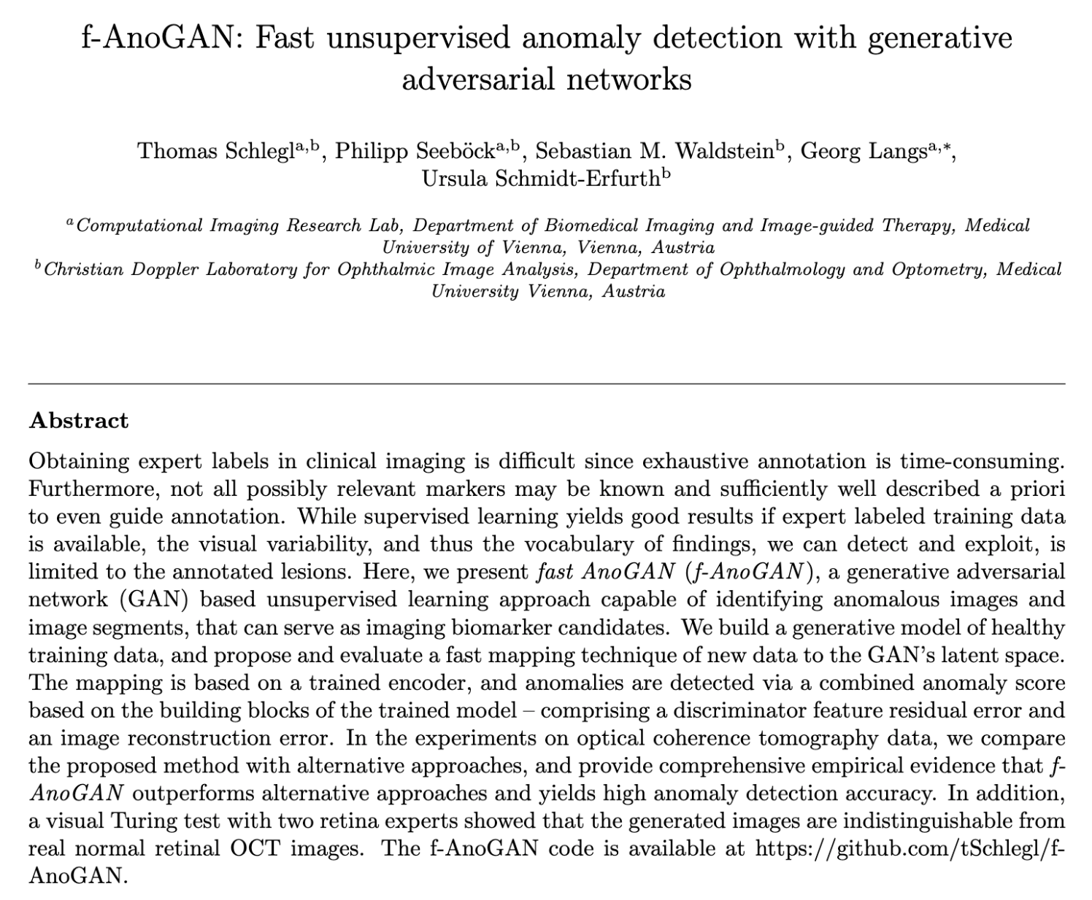

Slide 3
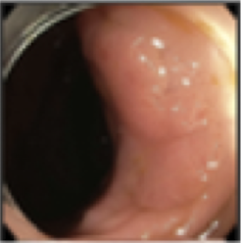
Anomaly Detection – Problem
> Detect an anomaly in an image
Anomaly
Detection
Input: image
Output: Detection

Slide 4

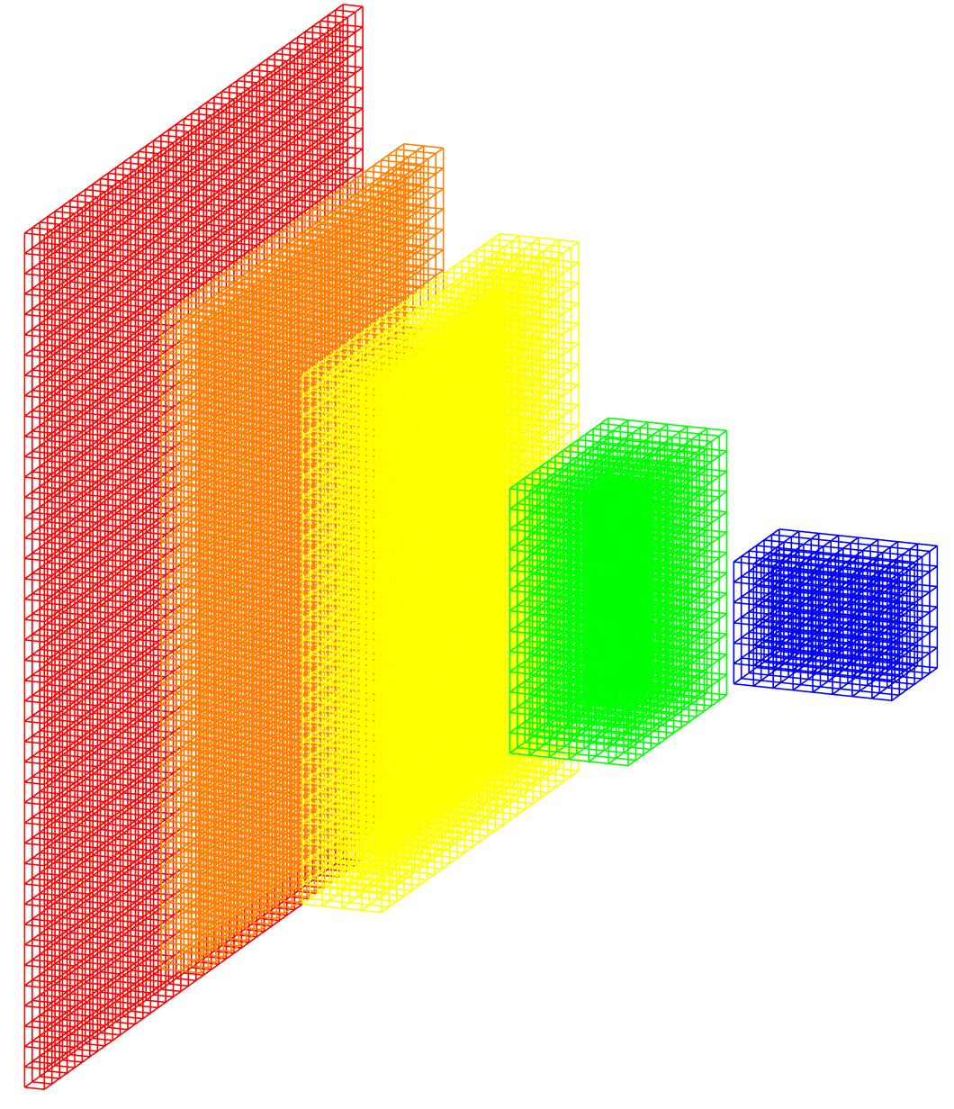
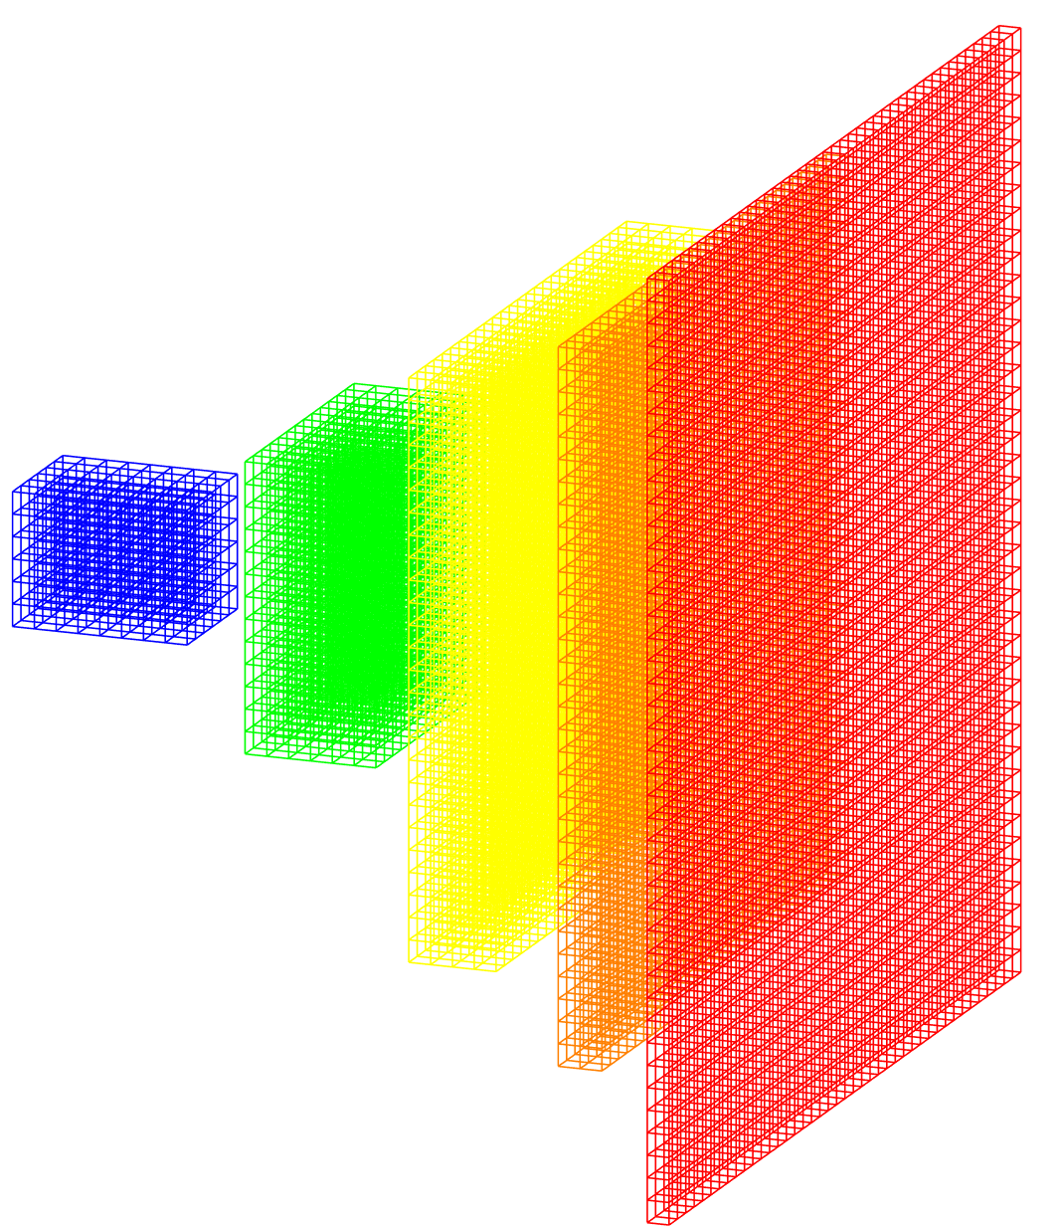
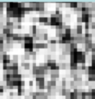
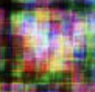
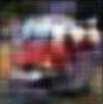
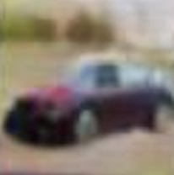
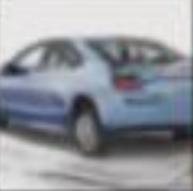
Anomaly Detection – Solution
Deep Learning Model: GAN
Generative Adversarial Network
Ground truth: real/fake
Real image
Discriminator
real/fake
Generator
error
Noise
Fake image
Iter = 1 500 10,000 50,000
error
Notes:
Zero-sum game theory

Slide 5
Anomaly Detection – Solution
Deep Learning Model: GAN
Generative Adversarial Network
Ground truth: real/fake
Real image
Discriminator
real/fake
Generator
error
Noise
Fake image
Iter = 1 500 10,000 50,000
error
Notes:
Zero-sum game theory

Slide 6
Anomaly Detection – Solution
Deep Learning Model: GAN
Generative Adversarial Network
Ground truth: real/fake
Real image
Discriminator
real/fake
Generator
error
Noise
Fake image
Iter = 1 500 10,000 50,000
error
Notes:
Zero-sum game theory

Slide 7
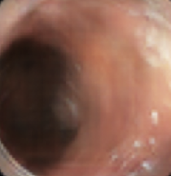
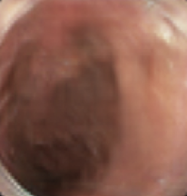
Anomaly Detection – Solution
Deep Learning Model: GAN
Generative Adversarial Network
Images without
anomalies
Ground truth: real/fake
Real image
Discriminator
real/fake
Generator
error
Noise
Fake image
error
Notes:
Zero-sum game theory

Slide 8
Anomaly Detection – Solution
Deep Learning Model: GAN
Generative Adversarial Network
Images without
anomalies
Ground truth: real/fake
Real image
Discriminator
real/fake
Generator
error
Noise
Fake image
error
Notes:
Zero-sum game theory

Slide 9

Anomaly Detection – Solution
Deep Learning Model: GAN
Generative Adversarial Network
Images without
anomalies
Encoder
Generator
Notes:
Zero-sum game theory

Slide 10
Anomaly Detection – Solution
Deep Learning Model: GAN
Generative Adversarial Network
Images without
anomalies
Encoder
Generator
error
Notes:
Zero-sum game theory

Slide 11
Anomaly Detection – Solution
Deep Learning Model: GAN
Generative Adversarial Network
Real Image
with anomaly
Encoder
Generator
Synthetic image
without anomaly
Anomalies
Notes:
Zero-sum game theory

Slide 12
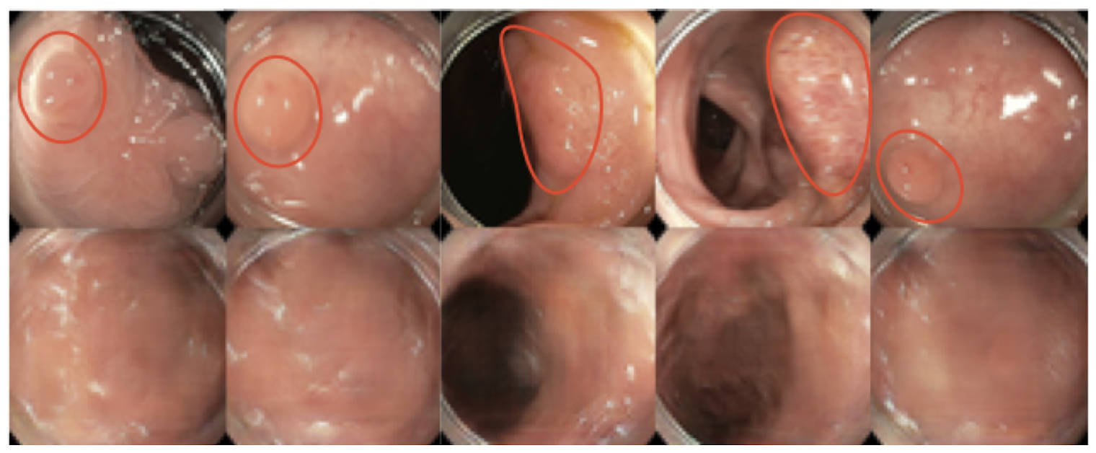
Anomaly Detection – Example
Colonoscopy video frames
Liu, Yuyuan, et al. "Photoshopping colonoscopy video frames." 2020 IEEE 17th International Symposium on Biomedical Imaging (ISBI). IEEE, 2020.

Slide 13
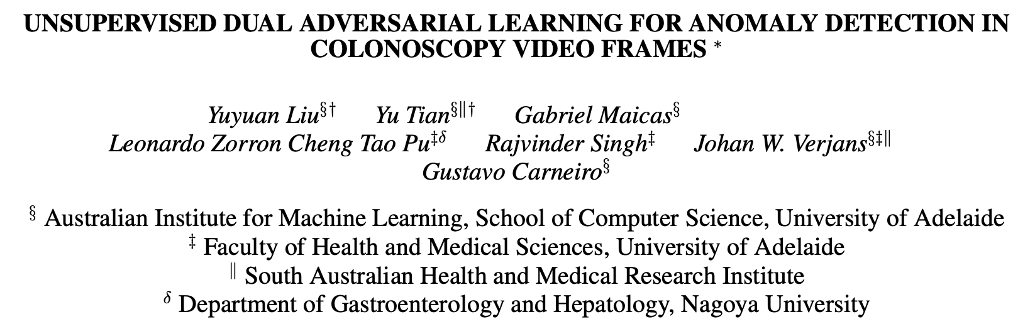
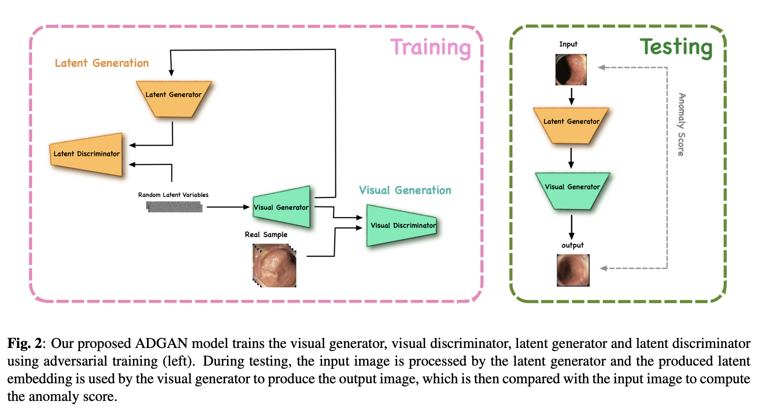

Slide 14
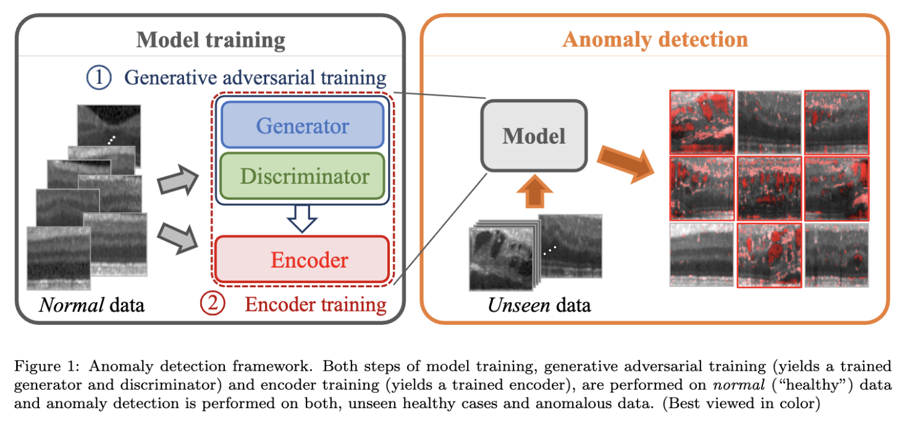

Slide 15
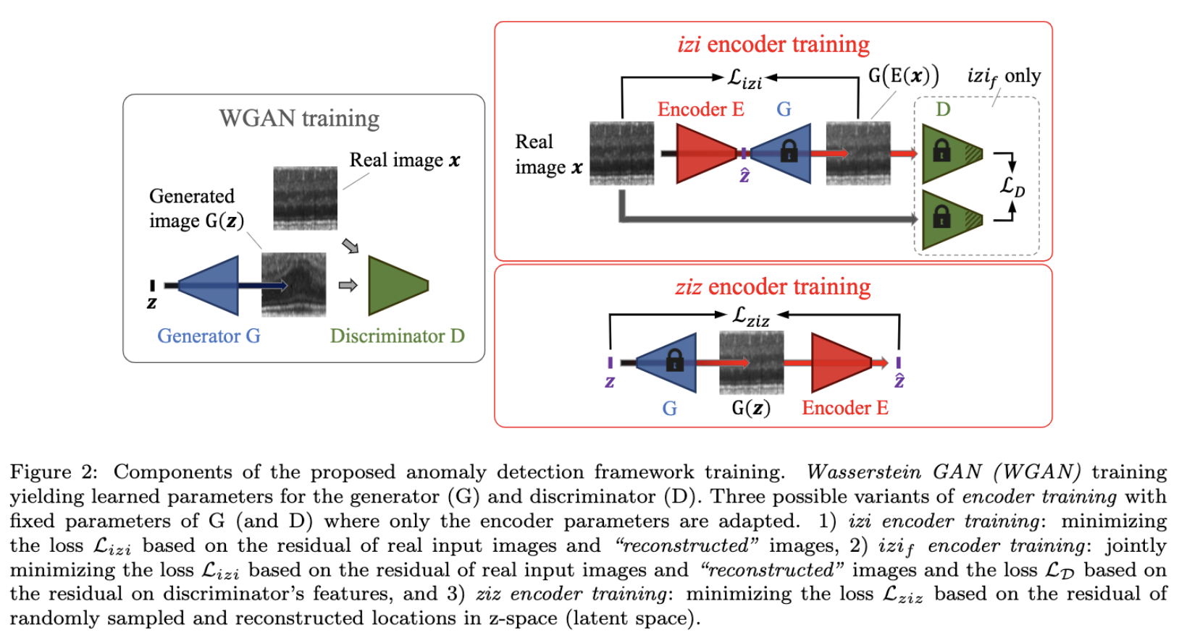

Slide 16
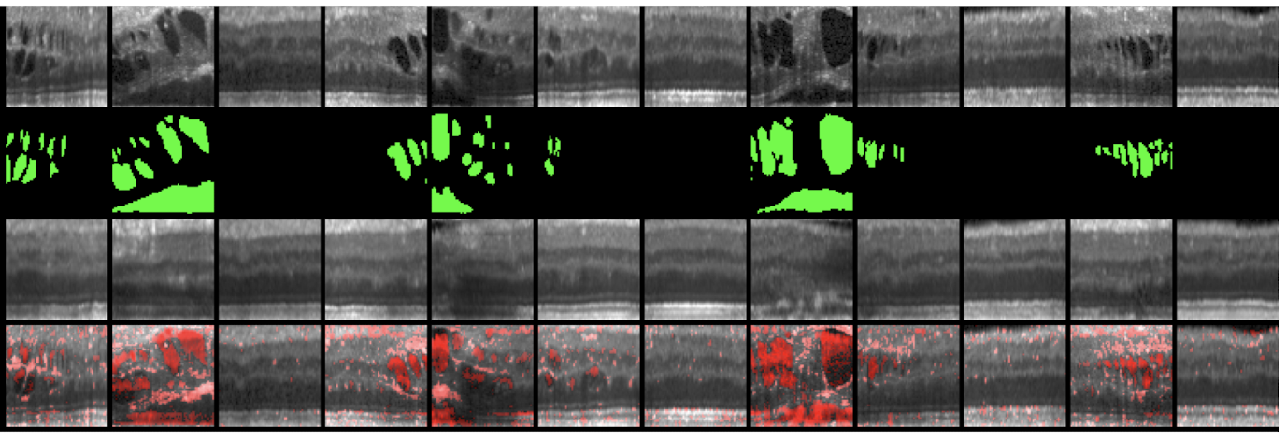
Anomaly Detection – Example
Retinal OCT images
Schlegl, Thomas, et al. "f-AnoGAN: Fast unsupervised anomaly detection with generative adversarial networks." Medical image analysis 54 (2019): 30-44.

Slide 17
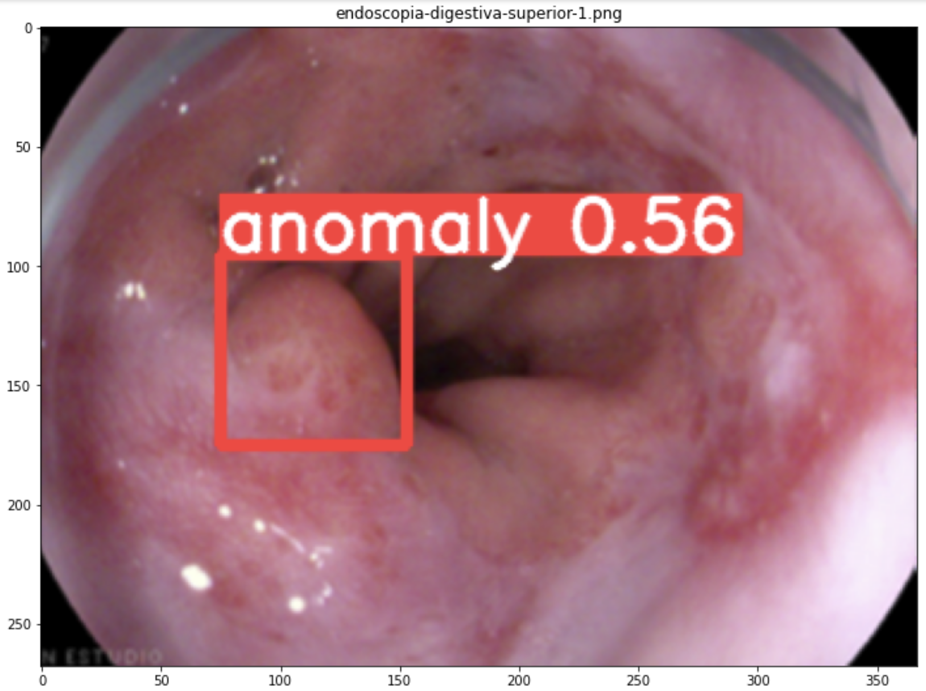
Anomaly Detection – Bonus Track
YOLOv5
Créditos:
Javier Tramon

